Slide 1
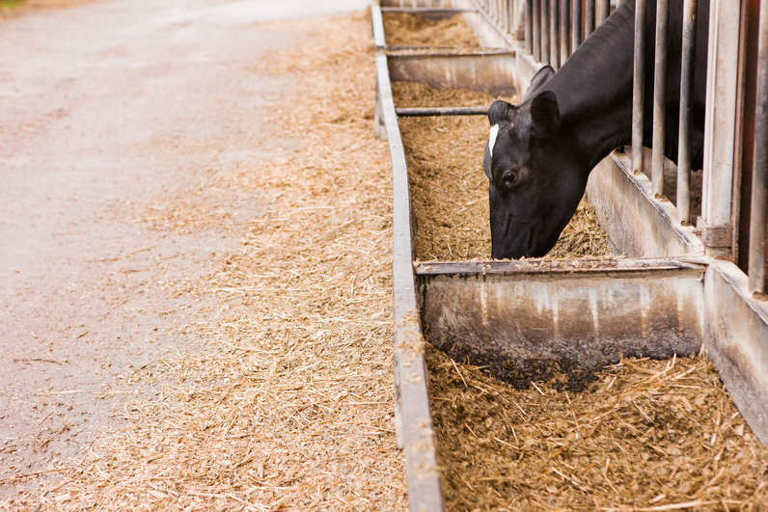
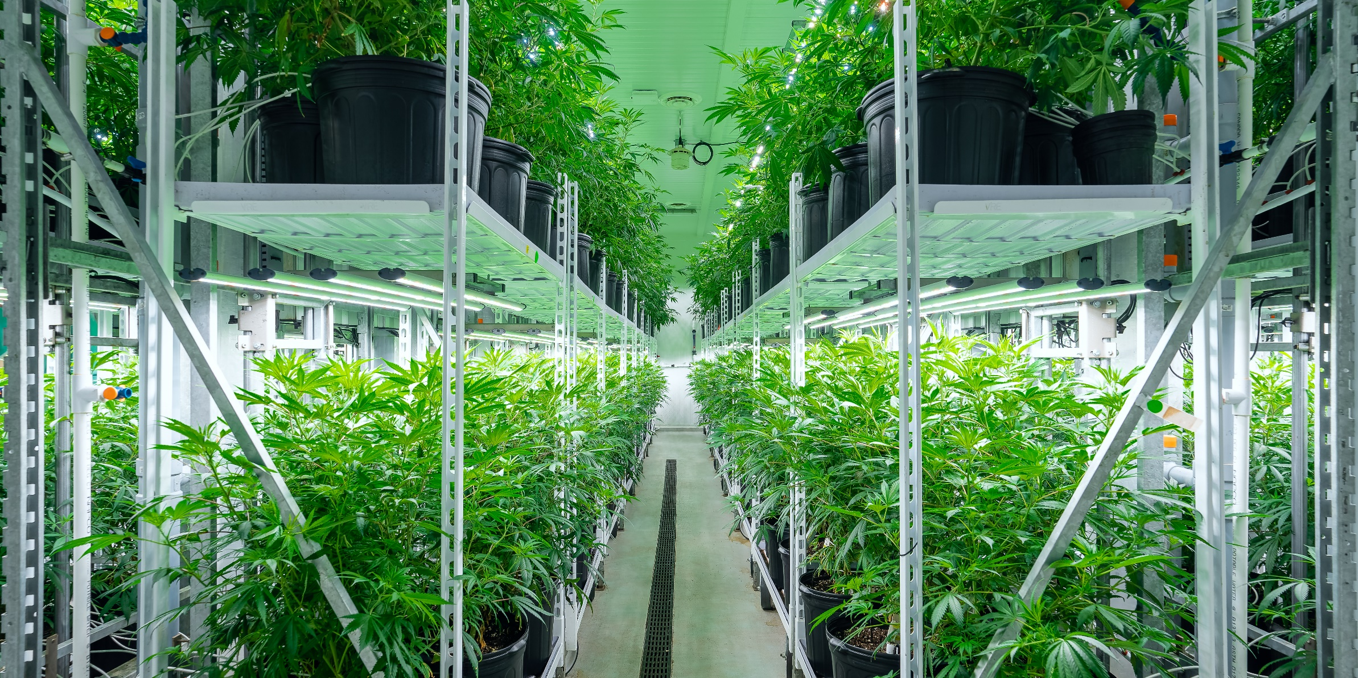


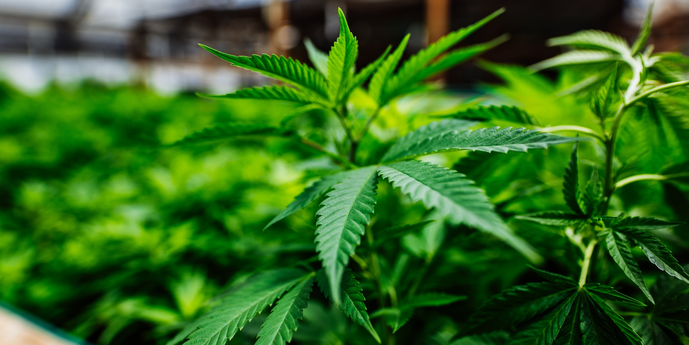
Growing the Bottom Line
Agricultural Growth through Energy Efficiency

Slide 2
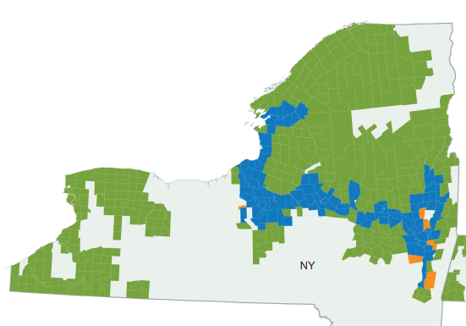
Seth Browe, Sr. Representative
Energy Efficiency
Jay Snyder, Sr. Representative
Energy Efficiency
Serving Commercial and Industrial Customers in the Eastern Mohawk Valley and the North Country; as well as Agribusiness Customers in Eastern, Central and Northern New York.
(c) 518-949-5815
(e) seth.browe@nationalgrid.com
Serving Commercial and Industrial Customers in the serval Western New York counties; as well as Agribusiness Customers Western New York.
(c) 716-517-5515
(e) john.snyderjr@nationalgrid.com

Slide 3
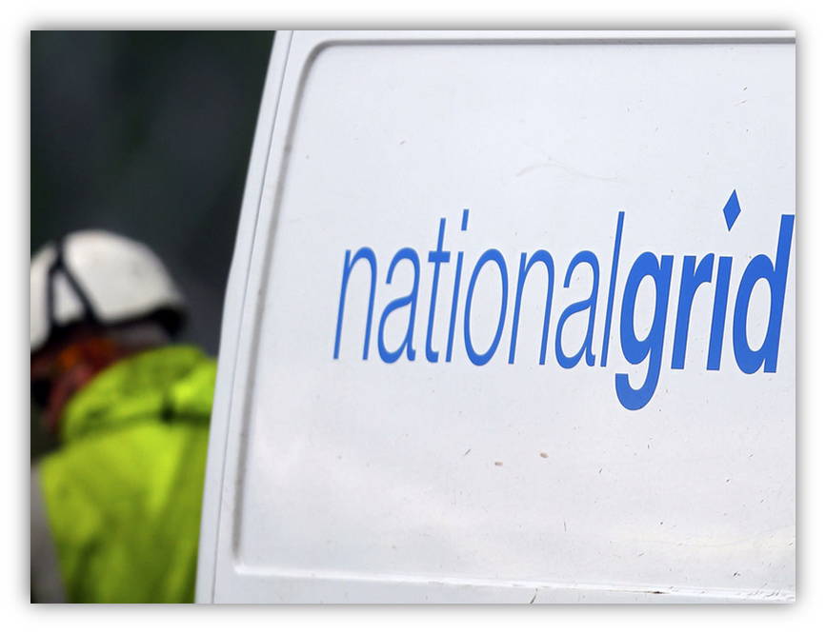
Energy Efficiency Overview
Purpose of the Program: What It Means For You?
A few key points:
    National Grid can only incentivize National Grid Energy
    Incentive v. Rebate
    Rx v. Custom

Slide 4
Energy Efficiency Overview
Purpose of the Program: What It Means For You?
The purpose of the National Grid Energy Efficiency Programs are to incentive you and your businesses to identify and install equipment that will save energy.
AEMP
Incentives
Identify
Install
Energy
Rewards
Plan
Low Cost
Financing
On-site
Visits

Slide 5
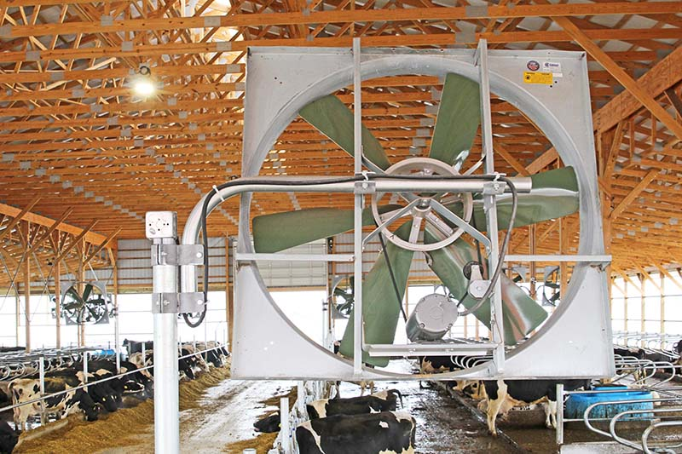
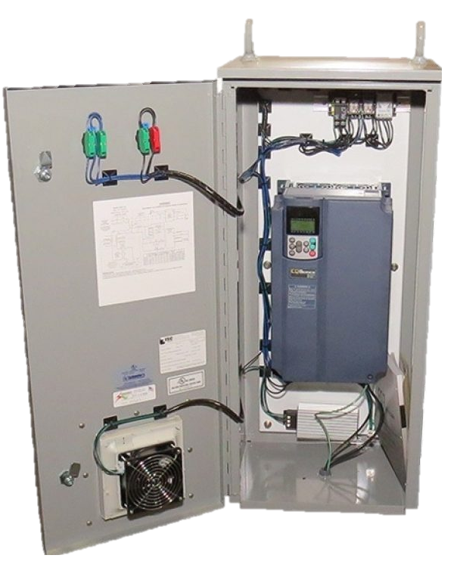
Energy Efficiency Program
Incentive Funding
Incentives are based on energy savings as compared to baseline energy consumption.
      For example, a fixed speed fan compared to a new high efficiency fan with a Variable Speed Drive.
Electric Incentives
(non-lighting)
$0.197 per kWh saved,
Up to 65% of project costs or
100% of incremental costs,
which ever is less.
Gas Incentives
Up to $4.00 per them saved
Up to 85% of project costs,
Capped at $250,000

Slide 6
Energy Efficiency Overview
Application Process
1
Step
Reach out to a National Grid Rep to Identify Opportunities and Confirm Eligibility
1
2
Work with Rep to plan Pre-Inspection and Prepare the Correct Application
Step
2
3
Application is Submitted for Technical Review by National Grid
Step
3

Slide 7
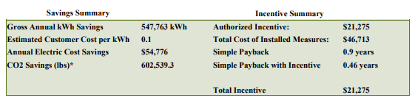
Energy Efficiency Overview
Application Process
4
Review Customer Report with Incentive and Savings Information & Accept
Step
4
Existing: 400W Metal Halide Lamp
Proposed: 120W LED High Bay Fixture
Project Cost Covered: 45%
Pay Back Improved: 50%

Slide 8
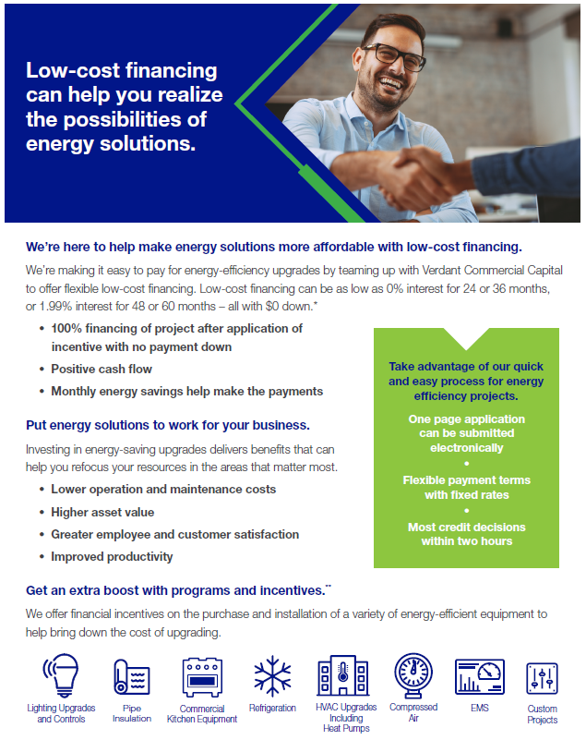
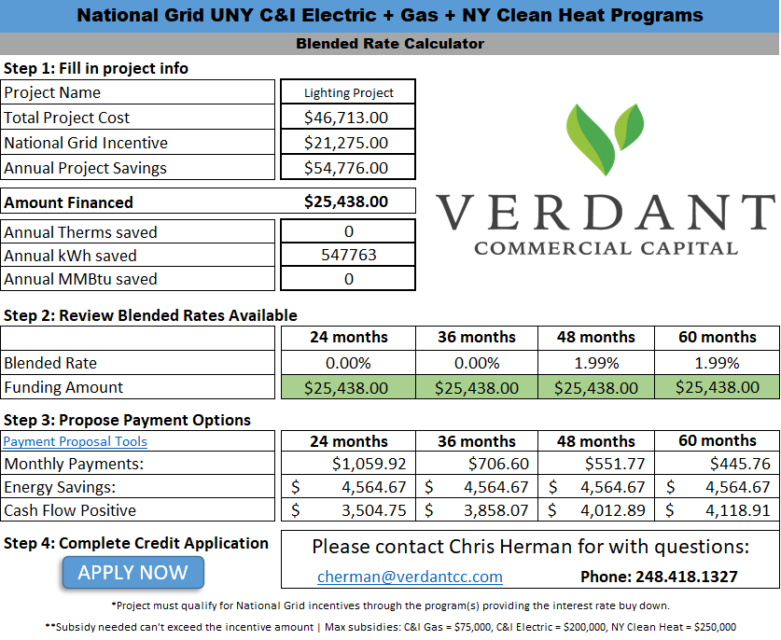
Other Programs
Low-Cost Financing

Slide 9
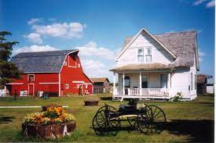


Other Programs
RAD – Residential Agricultural Discount Program
    The Residential Agricultural Discount Program is an electricity rate discount applied to the electricity delivery charge.
    You are eligible to receive the Residential Agricultural Discount if you meet the two conditions noted below:
      You have an active National Grid account billed under residential electric service classification - Electric SC1 or Electric SC1C; refer to page 2 of your bill
      You are an agricultural customer who has submitted either:
        Internal Revenue Service Form (“IRS”) - Schedule F (Form 1040) -Profit or Loss From Farming as filed with the customer’s most recent federal income tax return; or,
        IRS Form 1120, 1120S, or 1065 as filed with the customer’s most recent federal income tax return. The Business Activity indicated on the form must be one of the Business Activity codes listed below:
APPLY NOW!

Slide 10
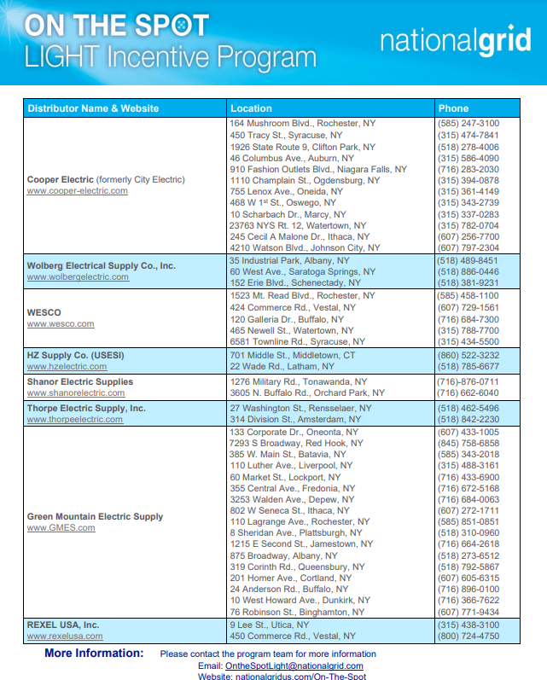
Other Programs
On the Spot
    A rebate program for LED Lighting.
    Get a rebate at the counter when you shop at participating distributor.
    Best for small and medium size projects.
    Limits apply.
Visit: https://www.nationalgridus.com/On-The-Spot

Slide 11

Other Programs
Economic Development
    Grants from our Economic Development group are available for a variety of different purposes.
      Marketing Programs
      Energy Infrastructure Programs
      Energy Efficiency & Productivity
      Site Development Programs
      Community Development Programs
      Clean Energy Programs
Visit ShovelReady.com

Slide 12
Other Programs
Commercial and Industrial
Other Programs
Small Business
    Search by:
      Customer Type
      Location (Service Area)
      Fuel Type (from National Grid)
    Incentives for:
      LED Lighting
      Natural Gas Equipment
      Custom Lighting and Refrigeration
Visit: www.nationalgridus.com/Services-Rebates
Visit: https://www.nationalgridus.com/upstate-ny-business/energy-saving-programs/small-business

Slide 13
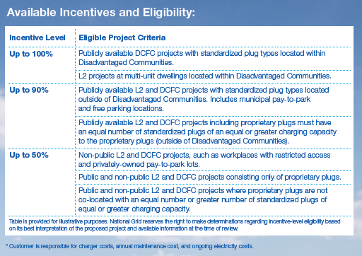
Other Programs
EV Charging Plugs

Slide 14
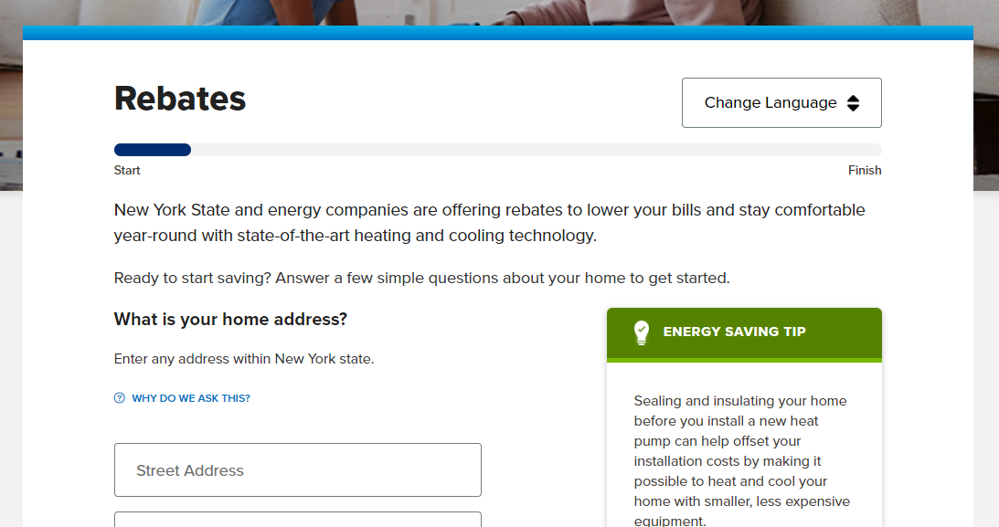
Other Programs
Clean Heat Program
Residential
Rebates
Commercial and Industrial Incentives – Call Seth!

Slide 15
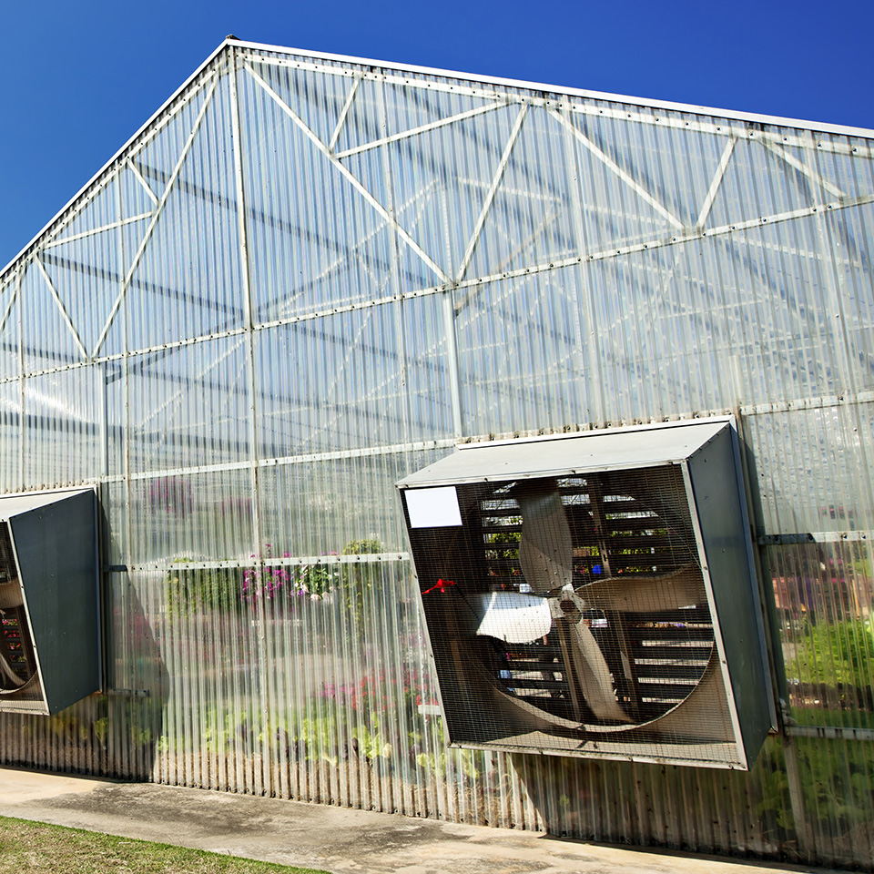
Questions?
Please Ask Your Questions in the Chat!

Slide 16
Seth Browe ♦ seth.browe@nationalgrid.com ♦ 518-949-5815

